Slide 1
Data Structures

Slide 2
Agenda
Problem on Matrix
Sorting – Bubble, Insertion, Selection

Slide 3
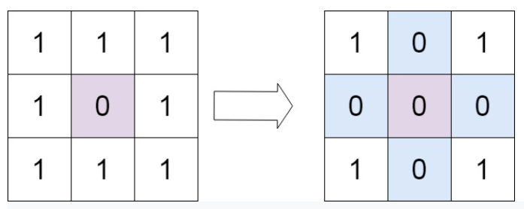
Set Matrix Zeroes Problem

Slide 4
Set Matrix Zeroes Problem

Slide 5
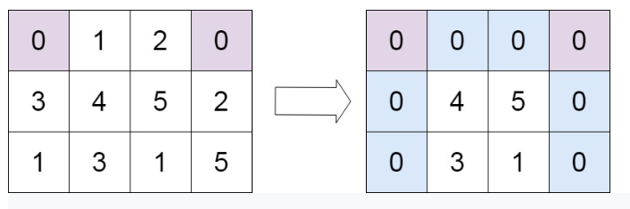
Set Matrix Zeroes Problem

Slide 6
Set Matrix Zeroes Problem

Slide 7
Set Matrix Zeroes Problem

Slide 8
Set Matrix Zeroes Problem

Slide 9
Set Matrix Zeroes Problem

Slide 10
Set Matrix Zeroes Problem

Slide 11
Selection Sort

Slide 12

Insertion Sort

Slide 13
Insertion Sort

Slide 14
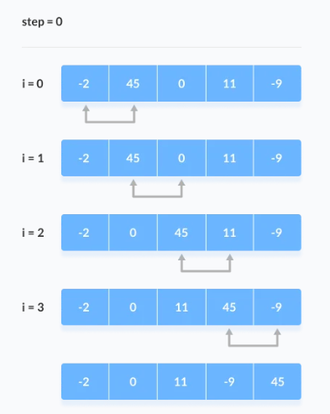
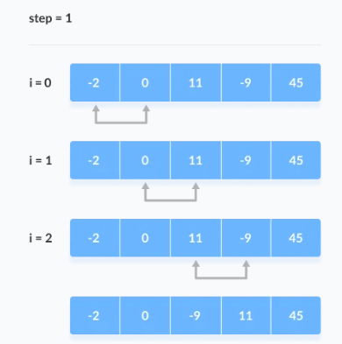
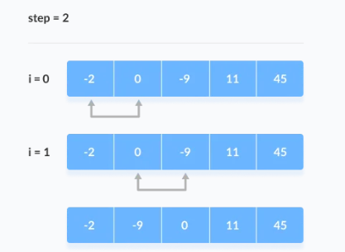
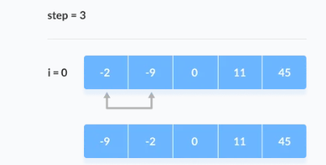
Bubble Sort

Slide 15
Bubble Sort

Slide 16
THANK YOU

